Slide 1

Satan’s
If I Were
MINISTER
(part 4)

Slide 2

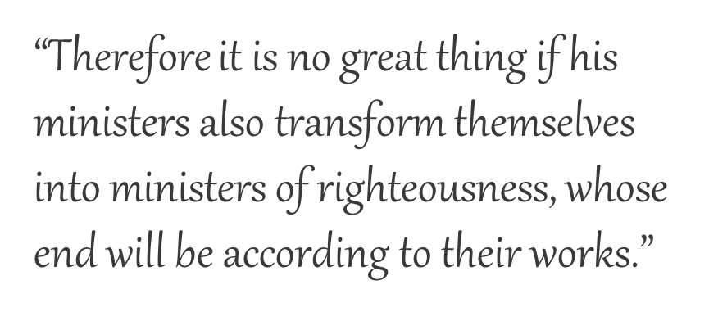
If I Were
SATAN’S MINISTER
2 Corinthians 11:15
I would:
Teach that someone like me does not exist
Promote the one-man-pastor system
Emphasize sincerity over truth
Embrace all forms of worship
Embrace Calvinism
(part 4)

Slide 3

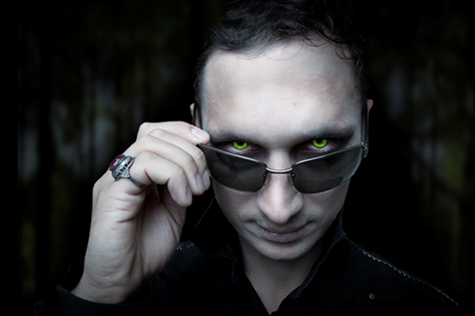
If I were Satan’s Minister…
“Faith is a gift of God.”
I would teach that man is depraved and therefore cannot believe unless God awakens his faith.

Slide 4

If I were Satan’s Minister…
Heart of man is incurably wicked
  Jer. 17:9
Everyone is in sin
  Rom. 3:9, 10
Everyone is dead in sin
  Eph. 2:1, 5
Unable to believe unless God gives faith

Slide 5
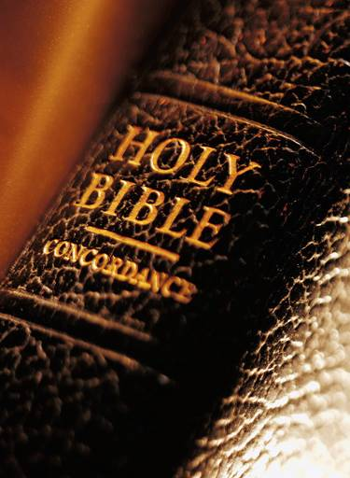
Jeremiah
Did not teach man is born with a depraved heart
Men chose to trust in man (17:5)
Men chose to “depart” from the Lord (17:5)
Men chose to “forsake” the Lord (17:13)
Alternative: trust in the Lord (17:7, 8)

Slide 6
Paul
Did not teach man was born a sinner
Man becomes a sinner (Rom. 3:12)
They had no fear of God (3:18)
Doing evil is an understood choice (3:7)

Slide 7

“Salvation by grace” is the central thought!
“For by grace you have been saved through faith, and that not of yourselves; it is the gift of God”
Ephesians 2:8

Slide 8
Salvation is the GIFT;
Faith is the CONDITION!
“For by grace you have been saved through faith, and that not of yourselves; it is the gift of God”
Ephesians 2:8

Slide 9

FAITH = action-based trust
Abel
Noah
Abraham
Abraham
Sarah
Abraham
Isaac
Israelites
Walls of Jericho
Offered
Prepared
Obeyed
Lived
Conceived
Offered
Blessed
Passed through
Encircled

Slide 10
Salvation of the Israelites
ACTION-BASED TRUST
EXODUS 14:13-15
“… Tell the children of Israel to go forward.”
HEBREWS 11:29
“By faith they passed through the Red Sea as by dry land, whereas the Egyptians, attempting to do so, were drowned.”

Slide 11
God’s work in waking up man from being dead in sin:
ALIVE TO GOD
Sending His Son
(1 Jn. 4:9)
Preaching the gospel (Rom. 1:16; Mk. 16:15,
16; Acts 8:12; 14:15; etc.)
Obedient response (Rom. 6:3, 6, 7, 16-18)
How?
Ephesians 2:1, 5
DEAD IN SIN
DEAD TO SIN

